Slide 1


INNOVERSITE - THE UNIVERSE OF INNOVATION
11-01-2025 - 12-01-2025
Financial Dashboards
SUBMITTED BY-
Aarthik Kandoliya, Ancita Mendonca , Aryaman Singh, Ayan Bhaskar, Garima Gupta, Shobhit Maitrey
MENTOR-
Mr. Saurabh and Mr. Ankit

Slide 2
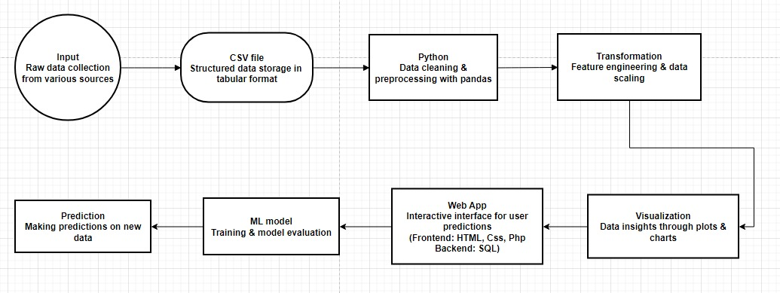
Structure Flow
Innoversite - The Universe Of Innovation
2

Slide 3
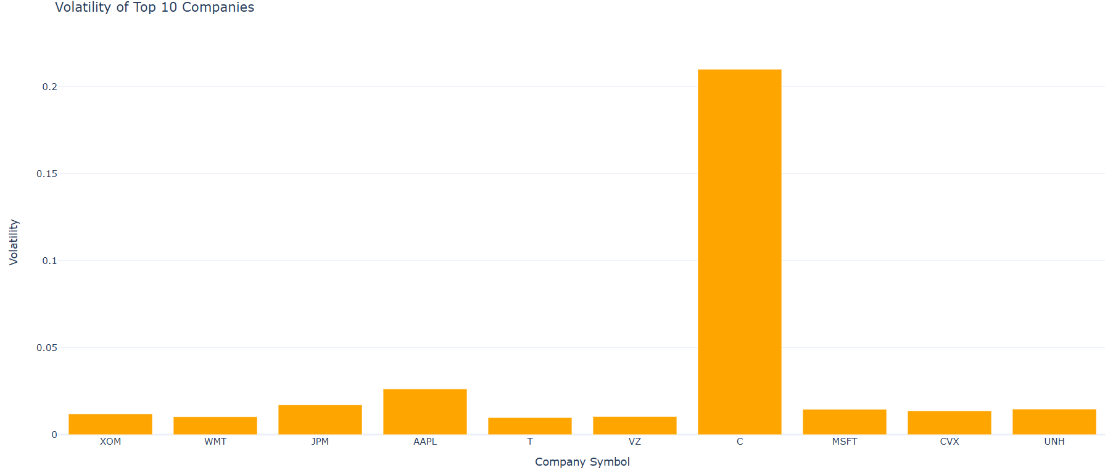
Gross Profit & Volatility Analysis
Innoversite - The Universe Of Innovation
Calculated the volatility assuming that there are 250 trading days.
3

Slide 4
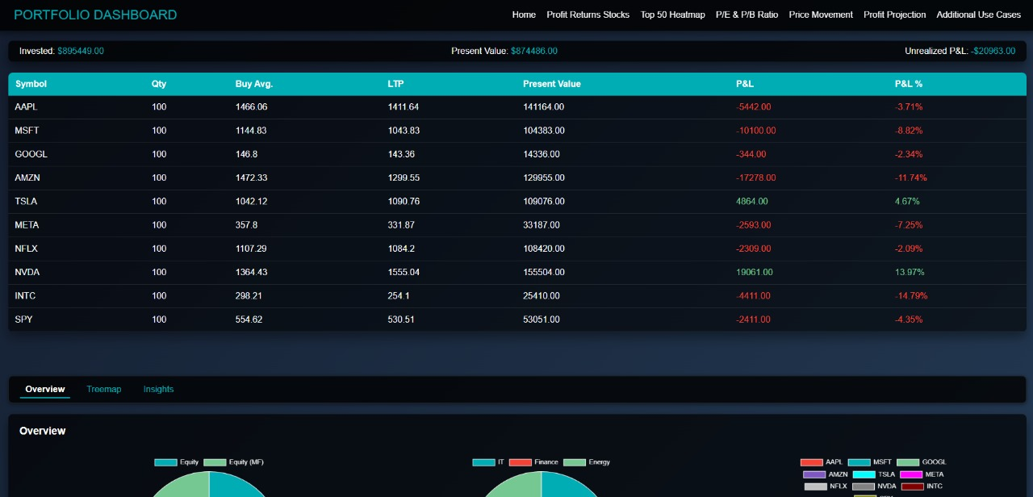
Portfolio Dashboard
Innoversite - The Universe Of Innovation
4

Slide 5
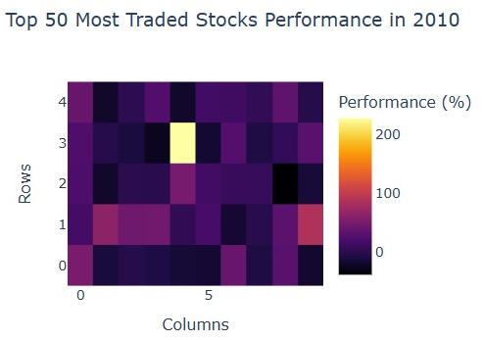
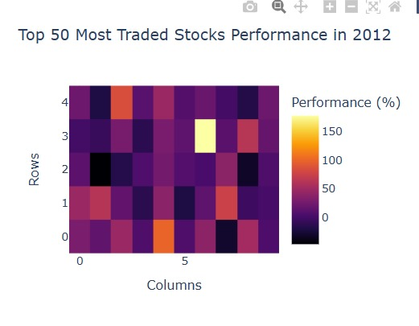
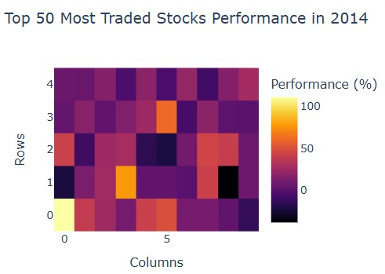
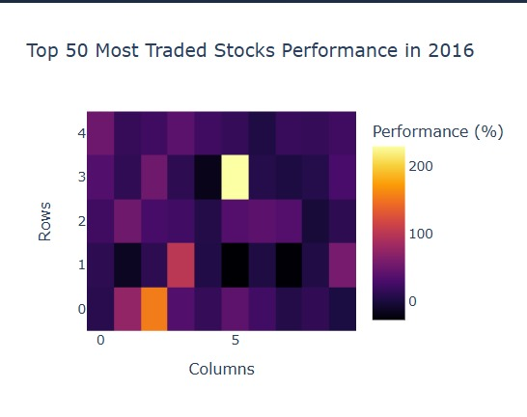
Heatmap
For the top 50 most traded stocks, a heatmap can illustrate price performance trends over a selected year, where rows represent stocks, columns represent time intervals (e.g., months), and cell colors indicate relative price changes or returns.
Innoversite - The Universe Of Innovation
5

Slide 6
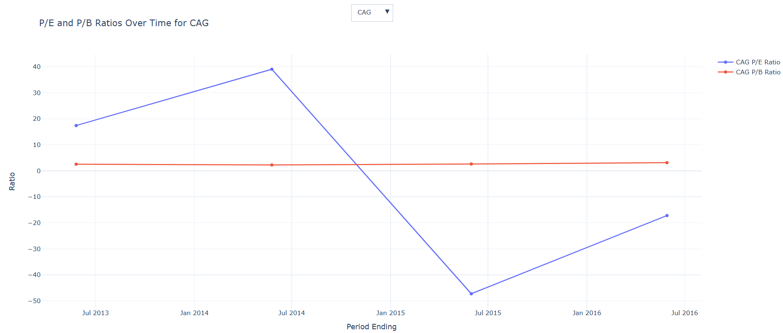
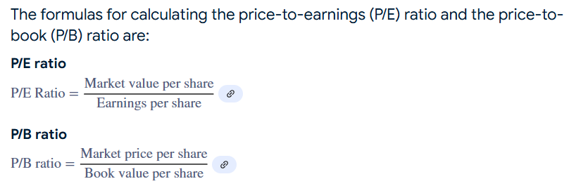
P/E & P/B Ratio
Innoversite - The Universe Of Innovation
6

Slide 7
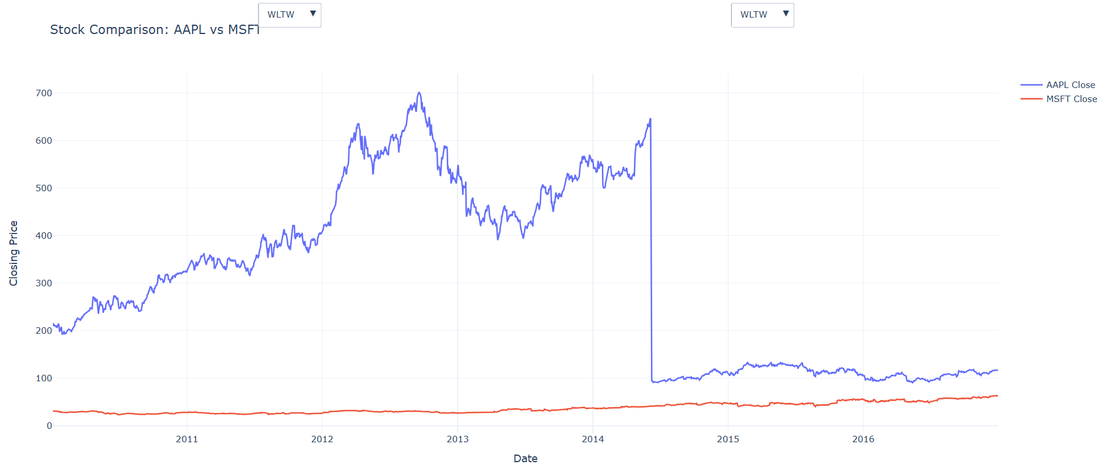
Comparative Stock Price Movement
Innoversite - The Universe Of Innovation
It is used to compare the growth of stocks within the given time frame.
7

Slide 8
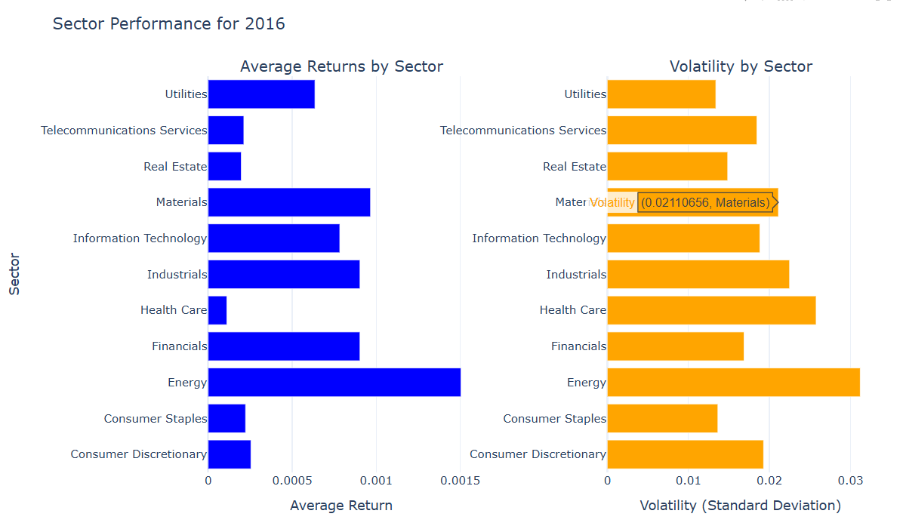
Sector Performance
Here is the comparison Graph of different industries on the basis of financial data using security file.
Innoversite - The Universe Of Innovation
8

Slide 9
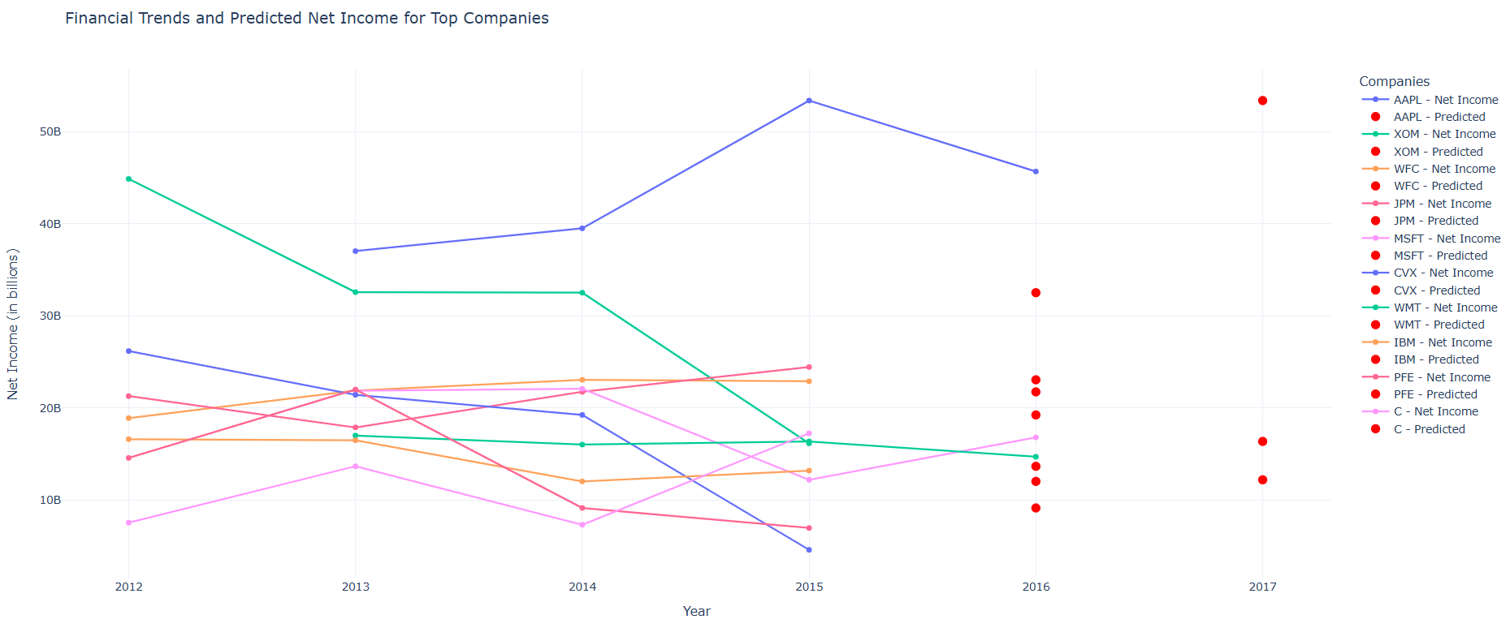
Profit Projection
Innoversite - The Universe Of Innovation
XGBRegressor is a regression model from the XGBoost (eXtreme Gradient Boosting) library, which is optimized for both performance and speed.
9

Slide 10
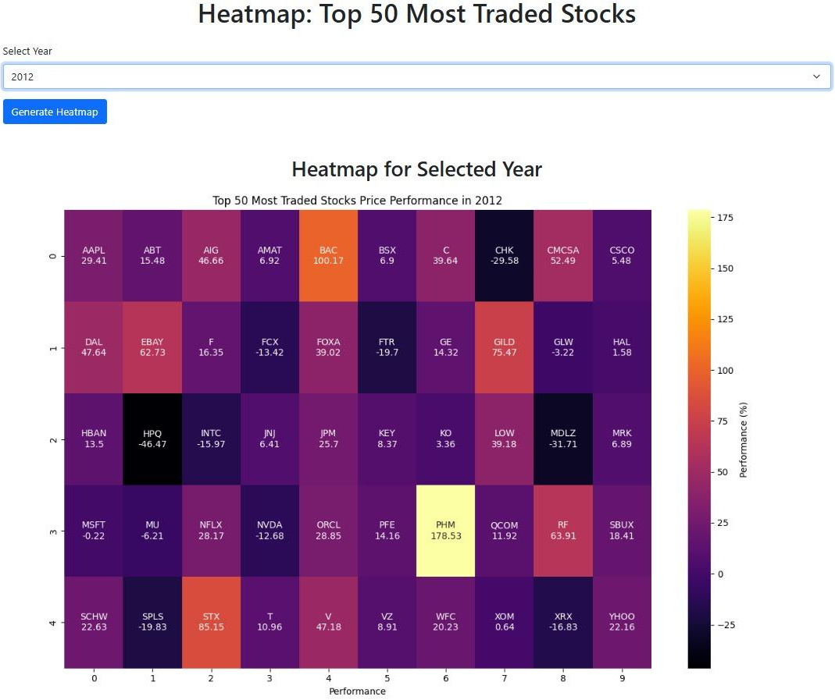
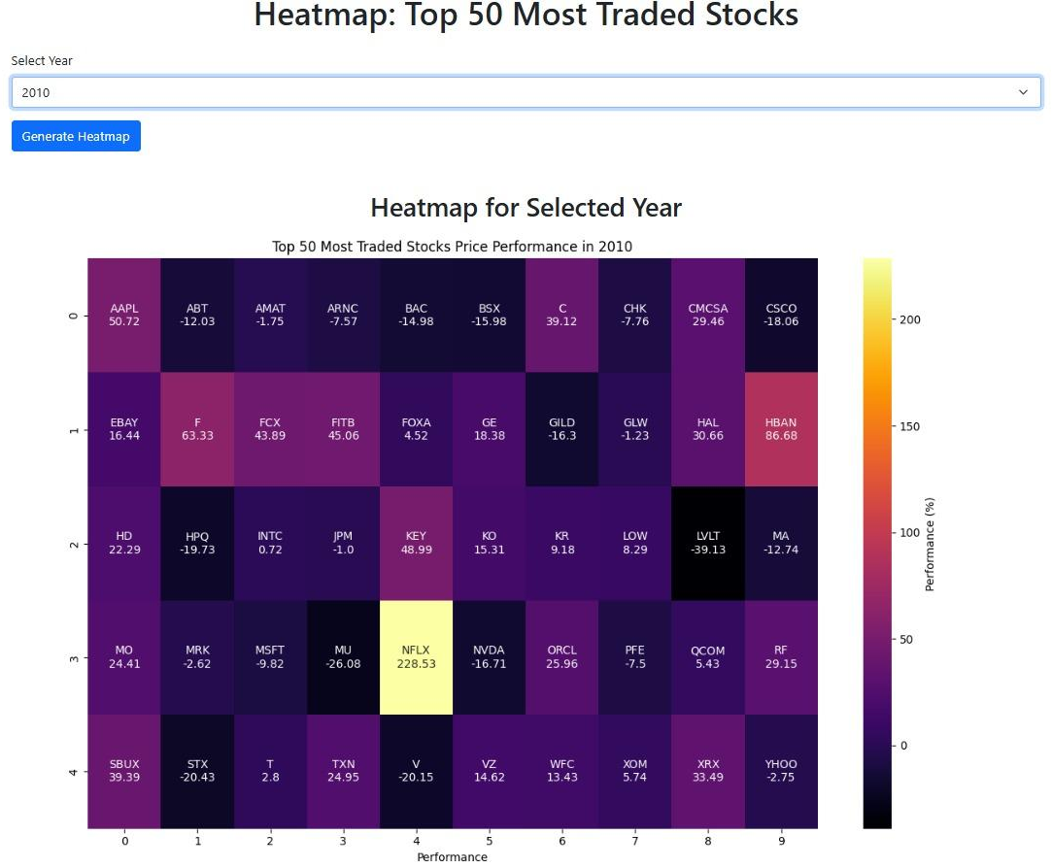
Challenges
Innoversite - The Universe Of Innovation
10

Slide 11
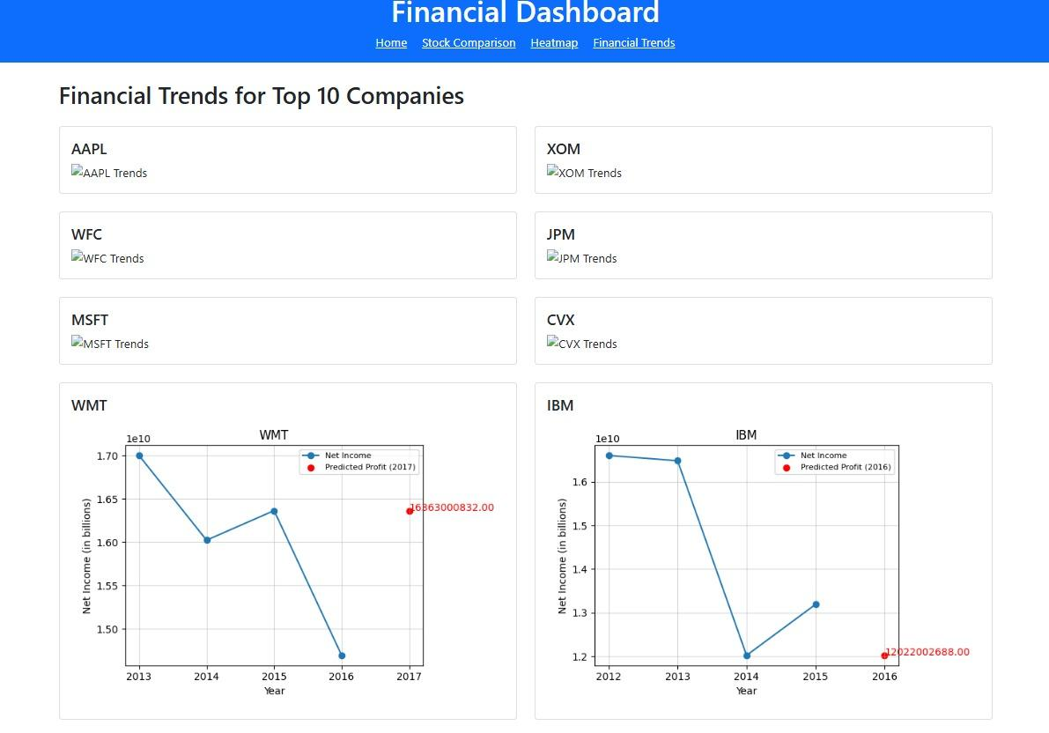
Challenges
Connecting the backend logic in Flask.
It was difficult to make the dashboard update dynamically.
Setting up the Flask application on our server was complicated.
Time Constraint.
Innoversite - The Universe Of Innovation
11

Slide 12
Thank You BNP PARIBAS for this Opportunity!

